Slide 1
Chapter 2
Instructions: Language of the Computer
张明敏
zhangmm95@zju.edu.cn
Notes:
1.1 Introduction

Slide 2
2.1 Introduction
Language of the computer
  Instructions
  Instruction set
Design goals
  Maximize performance
  Minimize cost
  Reduce design time
Our chosen instruction set: RISC-V
  developed at UC Berkeley starting in 2010
Notes:
1.1 Introduction
Instructions → Statement
Instruction set → Syntax
MIPS is developed since the 1980's, Used by NEC, Nintendo, Silicon Graphics, Sony

Slide 3
Instruction characteristics
wide variety
Operators
Op
Operands
Type of internal storage in processer
The number of the memory operand in the instruction
Operations in the instruction Set
Type and Size of Operands
Representation in the Computer
  Encoding
Notes:
操作数有不同含义：一个直接就是操作数，还有一个是告诉操作数所在的位置，这就叫寻址。
不同的处理器架构在指令格式上也有不同的特征，主要体现在5个方面。
历史上允许的存储器操作数最多的是3个。X86允许存储器中的操作数有2个，mips是不允许的
运算指令，传输指令，转移指令
硬件直接支持的操作数类型和大小：80%以上的操作数32位，95%以上的操作数64位
MIPS是定长的指令格式，Intel是不定长。
这5个特征是关于指令的，但是他们实质性地影响着处理器的具体架构。后期architecture还会深入介绍。
1.1 Introduction

Slide 4
Type of internal storage in processer
Stack
Accumulator
General purpose register
  Register-Memory
  Register-Register：load/store
Notes:
1.堆栈现在用的很少，但是在一些外部设备，接口中还会用到。比如磁盘的一些参数（磁道，扇区等等）放入堆栈。堆栈一开始使用是为了方便高级算法语言ALGOL，但是不够灵活。堆栈不仅可以在存储器中，也可以在寄存器中。
2.累加器，现在也还用的比较多，有一个操作数在累加器中，一个在存储器中，运算结果放在累加器中。比堆栈结构灵活。
3.Intel构架在2和3之间，所以又叫累加器扩展器，一开始在第1版教材是作为反面例子介绍的。80年代初，RICS问世之后，反响很好，广泛地被工作站，服务器接受，但是台式机方面没有获得很大的成功。Intel号称自己有8个寄存器，但实际上通用的只有4个。
3.Motorola处理器，比较多的GPR寄存器：通用寄存器，没有任何限制的寄存器。
1.1 Introduction

Slide 5
The number of the memory operand In the instruction
Register-Register
  Maximum number of operands allowed 3
  Number of memory addresses is 0
Register-memory
  Maximum number of operands allowed 2
  Number of memory addresses is 1
Memory-memory
  Maximum number of operands allowed 2 or 3
  Number of memory addresses is 2 or 3
Notes:
MIPS是第一类
1.1 Introduction

Slide 6
Variables difference
C
  Int char f
Instruction Set
  Register
  Memory address
    Displacement
    Immediate
  Stack
Notes:
算法语言把硬件细节屏蔽起来，是一个抽象，用字母表示就可以了。
但是机器指令是指向硬件的，所以他的变量也是直接指向硬件的，他的变量直接就是变量存放的载体。
80%的寻址方式是偏移量。
数组，堆是用堆栈方式
1.1 Introduction

Slide 7
2.2 Operations of the Computer Hardware
Every computer must be able to perform arithmetic:
  Only one operation per instruction
  Exactly three variables(add a, b, c # a=b+c)
Design Principle 1
  Simplicity favors regularity(简单源自规整，指令包含3个操作数）
Example(p65) Compiling two C assignment statements into RISC-V
  C code:
  a = b + c;
  d = a – e;
  RISC-V code:
  add a, b, c
  sub d, a, e
Notes:
1.1 Introduction

Slide 8
Example Compiling a complex C assignment
  C code:
  f = ( g + h ) – ( i + j );
  RISC-V code:
  add t0, g, h // temporary variable t0 contains g + h
  add t1, i, j // temporary variable t1 contains i + j
  sub f, t0, t1 // f gets t0 – t1
  RISC-V assembly language
Category | Instruction | Example | Meaning | Comments
Arithmetic | add | add a,b,c | a←b+c | Always three operands
 | subtract | sub a,b,c | a←b-c | Always three operands

Slide 9
RISC-V operands
Name | Example | Comments
32 registers | x0-x31 | Fast locations for data. In RISC-V, data must be in registers to perform arithmetic. Register x0 always equals 0.
2⁶¹ memory words | Memory[0], Memory[8] , …… , Memory[18446744073709551608] | Accessed only by data transfer instructions. RISC-V uses byte addresses, so sequential doubleword accesses differ by 8. Memory holds data structures, arrays, and spilled registers.
Notes:
2^64 – 1844674407370955161 【18446744073709551608， 最后一个字节】
Memory[0] 和 Memory[1] 差一个byte
Memory[8] 和 Memory[0] 差8个byte，doublewords
2^64寻址空间， 每一个doubleword是8个字节。
byte addresses： 每一个地址对应的是一个byte
1.1 Introduction

Slide 10
RISC-V assembly language
Category | Instruction | Example | Meaning | Comments
Arithmetic | add | add x5,x6,x7 | x5=x6 + x7 | Add two source register operands
 | subtract | sub x5,x6,x7 | x5=x6 - x7 | First source register subtracts second one
 | add immediate | addi x5,x6,20 | x5=x6+20 | Used to add constants
Data transfer | load doubleword | ld x5, 40(x6) | x5=Memory[x6+40] | doubleword from memory to register
 | store doubleword | sd x5, 40(x6) | Memory[x6+40]=x5 | doubleword from register to memory
 | load word | lw x5, 40(x6) | x5=Memory[x6+40] | word from memory to register
 | load word, unsigned | lwu x5, 40(x6) | x5=Memory[x6+40] | Unsigned word from memory to register
 | store word | sw x5, 40(x6) | Memory[x6+40]=x5 | word from register to memory
 | load halfword | lh x5, 40(x6) | x5=Memory[x6+40] | Halfword from memory to register

Slide 11
RISC-V assembly language
Category | Instruction | Example | Meaning | Comments
Data transfer | load halfword, unsigned | lhu x5, 40(x6) | x5=Memory[x6+40] | Unsigned halfword from memory to register
 | store halfword | sh x5, 40(x6) | Memory[x6+40]=x5 | halfword from register to memory
 | load byte | lb x5, 40(x6) | x5=Memory[x6+40] | byte from memory to register
 | load word, unsigned | lbu x5, 40(x6) | x5=Memory[x6+40] | Unsigned byte from memory to register
 | store byte | sb x5, 40(x6) | Memory[x6+40]=x5 | byte from register to memory
 | load reserved | lr.d x5,(x6) | x5=Memory[x6] | Load;1st half of atomic swap
 | store conditional | sc.d x7,x5,(x6) | Memory[x6]=x5; x7 = 0/1 | Store;2nd half of atomic swap
 | Load upper immediate | lui x5,0x12345 | x5=0x12345000 | Loads 20-bits constant shifted left 12 bits
Notes:
2.10和2.11节内容
The atomic memory operation extension supports two types of atomic memory operations for release consistency. First, it provides general purpose load-reserved lr and store-conditional sc instructions. lr performs a load, and tries to reserve that address for its thread. A later store-conditional sc to the reserved address will be performed only if the reservation is not broken by an intervening store from another source. If the store succeeds, a zero is placed in a register. If it failed, a non-zero value indicates that software needs to retry the operation. In either case, the reservation is released.
1.1 Introduction

Slide 12
RISC-V assembly language
Category | Instruction | Example | Meaning | Comments
Logical | and | and x5, x6, 3 | x5=x6 & 3 | Arithmetic shift right by register
 | inclusive or | or x5,x6,x7 | x5=x6 | x7 | Bit-by-bit OR
 | exclusive or | xor x5,x6,x7 | x5=x6 ^ x7 | Bit-by-bit XOR
 | and immediate | andi x5,x6,20 | x5=x6 & 20 | Bit-by-bit AND reg. with constant
 | inclusive or immediate | ori x5,x6,20 | x5=x6 | 20 | Bit-by-bit OR reg. with constant
 | exclusive or immediate | xori x5,x6,20 | X5=x6 ^ 20 | Bit-by-bit XOR reg. with constant
Shift | shift left logical | sll x5, x6, x7 | x5=x6 << x7 | Shift left by register
 | shift right logical | srl x5, x6, x7 | x5=x6 >> x7 | Shift right by register
 | shift right arithmetic | sra x5, x6, x7 | x5=x6 >> x7 | Arithmetic shift right by register
 | shift left logical immediate | slli x5, x6, 3 | x5=x6 << 3 | Shift left by immediate
Notes:
SLLI (Shift Left Logical Immediate).
SRLI (Shift Right Logical Immediate).
SRAI (Shift Right Arithmetic Immediate).
1.1 Introduction

Slide 13
RISC-V assembly language
Category | Instruction | Example | Meaning | Comments
Shift | shift right logical immediate | srli x5,x6,3 | x5=x6 >> 3 | Shift right by immediate
 | shift right arithmetic immediate | srai x5,x6,3 | x5=x6 >> 3 | Arithmetic shift right by immediate
Conditional branch | branch if equal | beq x5, x6, 100 | if(x5 == x6) go to PC+100 | PC-relative branch if registers equal
 | branch if not equal | bne x5, x6, 100 | if(x5 != x6) go to PC+100 | PC-relative branch if registers not equal
 | branch if less than | blt x5, x6, 100 | if(x5 < x6) go to PC+100 | PC-relative branch if registers less
 | branch if greater or equal | bge x5, x6, 100 | if(x5 >= x6) go to PC+100 | PC-relative branch if registers greater or equal
 | branch if less, unsigned | bltu x5, x6, 100 | if(x5 >= x6) go to PC+100 | PC-relative branch if registers less, unsigned
 | branch if greater or equal, unsigned | bgeu x5, x6, 100 | if(x5 >= x6) go to PC+100 | PC-relative branch if registers greater or equal, unsigned

Slide 14
RISC-V assembly language
Category | Instruction | Example | Meaning | Comments
Unconditional branch | jump and link | jal x1, 100 | x1 = PC + 4; go to PC+100 | PC-relative procedure call
 | jump and link register | jalr x1, 100(x5) | x1 = PC + 4; go to x5+100 | procedure return; indirect call

Slide 15
2.3 Operands of the Computer Hardware
Register Operands
Memory Operands
Constant or Immediate Operand
Notes:
1.1 Introduction

Slide 16
Register Operands
Arithmetic instructions operands must be registers or immediate
  32 registers in RISC-V
  64 bits for each register in RISC-V
Design Principle 2
  Smaller is faster（越少越快，寄存器个数一般不超过32个）
RISC-v register operand
  Size is 64 bits, which named doubleword
Notes:
1.1 Introduction

Slide 17
RISC-V register conventions
Name | Register name | Usage | Preserved On call?
x0 | 0 | The constant value 0 | n.a.
x1(ra) | 1 | Return address(link register) | yes
x2(sp) | 2 | Stack pointer | yes
x3(gp) | 3 | Global pointer | yes
x4(tp) | 4 | Thread pointer | yes
x5-x7 | 5-7 | Temporaries | no
x8-x9 | 8-9 | Saved | yes
x10-x17 | 10-17 | Arguments/results | no
x18-x27 | 18-27 | Saved | yes
x28-x31 | 28-31 | Temporaries | no
Notes:
x5
1.1 Introduction

Slide 18
Example(p67) Compiling a C statement using registers
  C code
  f = ( g + h ) – ( i + j ) ;
  RISC-V code
  add x5, x20, x21 // register x5 contains g + h
  add x6, x22, x23 // register x6 contains i + j
  sub x19, x5, x6 // f gets x5 – x6, which is ( g + h ) – ( i + j )

Slide 19
Memory Operands
Advantage
  Could save much more data
  Save complex data structures
    Arrays and structures
Data transfer instructions
  Load: from memory to register; load word ( lw )
  Store: from register to memory; store word( sw )
Memory addresses and contents at those locations
3
1
0
0
2
1
0
1
1
0
1
0
1
Address
D
a
t
a
Processor
Memory
Notes:
MIPS算术运算指令只作用于寄存器，所以必须有数据传送指令。
Memory好比一个很大的一维数组，memory address相当于数组下标
1.1 Introduction

Slide 20
Example(p69 ) Compiling with an operand in memory
C code:
  g = h + A[8] ; // A is an array of 100 doublewords
  ( Assume: g ---- x20 h ---- x21 base address of A ---- x22 )
RISC-V code:
  ld x9, 64(x22) // temporary reg x9 gets A[8]
  add x20, x21, x9 // g = h + A[8]
  Offset: the constant in a data transfer instruction →64
  Base register: the register added to form the address →64(x22)
Byte/Half-word/word addressing
Alignment restriction
  RISC-V and x86 do not, but MIPS does
Endianness/byte order
Notes:
The operands for all arithmetic and logic operations are contained in registers. To operate on data in main memory, the data is first copied into registers. A load operation copies data from main memory into a register. A store operation copies data from a register into main memory .
When a word (4 bytes) is loaded or stored the memory address must be a multiple of four. This is called an alignment restriction. Addresses that are a multiple of four are called word aligned. This restriction makes the hardware simpler and faster.
The lw instruction loads a word into a register from memory. The sw instruction stores a word from a register into memory. Each instruction specifies a register and a memory address (details in a few pages).
1.1 Introduction

Slide 21
Memory Alignment
正确
struct {
int a;
char b;
char c[2];
char d[3]
float e;
}
e
d[1]
d[2]
No use
No use
b
c[0]
c[1]
d[0]
a
错误
e
No use
No use
因为一次只能读出4字节内存中的一行
这样布局，e变量不能一次读出
d[1]
d[2]
e
b
c[0]
c[1]
d[0]
a
Notes:
1.1 Introduction

Slide 22
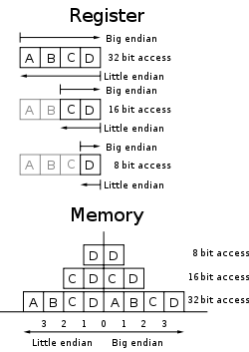
Endianness/byte order
Big end：Leftmost
  PowerPC
  01 02 = 258
Little end：Rightmost
  RISC-V
  01 02 = 513
Bi-endian
  MIPS, ARM , Alpha, SPARC
Notes:
Bi-endian
Some architectures (including ARM versions 3 and above, PowerPC, Alpha, SPARC V9, MIPS, PA-RISC, SuperH SH-4 and IA-64) feature a setting which allows for switchable endianness in data fetches and stores, instruction fetches, or both. This feature can improve performance or simplify the logic of networking devices and software. The word bi-endian, when said of hardware, denotes the capability of the machine to compute or pass data in either endian format.
1.1 Introduction

Slide 23
Example(p71) Compiling using load and store
  C code:
  A[12] = h + A[8] ; // A is an array of 100 words
  ( Assume: h ---- x21 base address of A ---- x22 )
  RISC-V code:
  ld x9 , 64(x22) // temporary reg x9 gets A[8]
  add x9, x21, x9 // temporary reg x9 gets h + A[8]
  sd x9, 96(x22) // stores h + A[8] back into A[12]

Slide 24
Registers vs. Memory
Registers are faster to access than memory
Operating on memory data requires loads and stores
  More instructions to be executed
Compiler must use registers for variables as much as possible
  Only spill to memory for less frequently used variables
  Register optimization is important!

Slide 25
Discussion：How to represent?
Constant
g = h + 55
  Many time a program
  will use a constant in an operation
Notes:
1.1 Introduction

Slide 26
Constant or Immediate Operands
Constant or immediate Operands
  Many time a program will use a constant in an operation
    Incrementing index to point to next element of array
    Add the constant 4 to register x22
    Assuming AddrConstants 4 is address pointer of constant 4
ld x9, AddrConstant4(x3) // x9=constant 4
add x22, x22, x9
  Immediate: Other method for adding constant 4 to x22
    Avoids the load instruction
    Offer versions of the instruction
    addi x22, x22, 4 // x22= x22+ 4
  Constant zero: a register x0
Design Principle 3
  Make the common case fast: (why?)
  Constant operands occur frequently
  it is very common
  Loading them from memory is very slow
x3
….
AddrConstants 4
4

Slide 27
2.4 signed and unsigned numbers
Bits are just bits (no inherent meaning): conventions define relationship between bits and numbers
Binary numbers (base 2)
0000 0001 0010 0011 0100 0101 0110 0111 1000 1001...
decimal: 0...2^{n}-1
Of course it gets more complicated:
numbers are finite (overflow)
fractions and real numbers
negative numbers
How do we represent negative numbers?
which bit patterns will represent which numbers?

Slide 28
Unsigned Binary Integers
Given an n-bit number
Range: 0 to +2^{n} – 1
Example
  0000 0000 0000 0000 0000 0000 0000 1011₂
  = 0 + … + 1×2³ + 0×2² +1×2¹ +1×2⁰
  = 0 + … + 8 + 0 + 2 + 1 = 11₁₀
Using 64 bits
  0 to 2⁶⁴ -1(18,446,774,073,709,551,615)

Slide 29
2’s-Complement Signed Integers
Given an n-bit number
Range: –2^{n – 1} to +2^{n – 1} – 1
Example
  1111 1111 1111 1111 1111 1111 1111 1100₂
  = –1×2³¹ + 1×2³⁰ + … + 1×2² +0×2¹ +0×2⁰
  = –2,147,483,648 + 2,147,483,644 = –4₁₀
Using 64 bits
  –9,223,372,036,854,775,808 to + 9,223,372,036,854,775,807
Notes:
取补+1
1.1 Introduction

Slide 30
2’s-Complement Signed Integers
Bit 63 is sign bit in a 64-bits integer
  1 for negative numbers
  0 for non-negative numbers
–(–2^{n – 1}) can’t be represented
Non-negative numbers have the same unsigned and 2s-complement representation
Some specific numbers
  0: 0000 0000 … 0000
  –1: 1111 1111 … 1111
  Most-negative: 1000 0000 … 0000
  Most-positive: 0111 1111 … 1111

Slide 31

Signed Negation
Complement and add 1
  Complement means 1 → 0, 0 → 1
Example: negate +2
  +2 = 0000 0000 … 0010₂
  –2 = 1111 1111 … 1101₂ + 1
  = 1111 1111 … 1110₂

Slide 32
Sign Extension
Representing a number using more bits
  Preserve the numeric value
In RISC-V instruction set
  addi: extend immediate value
  lb, lh,lw: extend loaded byte/halfword/word
  beq, bne: extend the displacement
Replicate the sign bit to the left
  c.f. unsigned values: extend with 0s
Examples: 8-bit to 16-bit
  +2: 0000 0010 => 0000 0000 0000 0010
  –2: 1111 1110 => 1111 1111 1111 1110

Slide 33
Other representations
text characters
  ASCII,GB2312,Unicode(UTF-8)
Floating point numbers
  numeric calculations
  Different grades of precision
    Single precision (IEEE)
    Double precision (IEEE)
    Quadruple precision
Instructions in the Computer

Slide 34
2.5 representing Instructions in the computer
All information in computer consists of binary bits
Instructions are encoded in binary
  Called machine code
Mapping registers into numbers
  map registers x0 to x31 onto registers 0 to 31
RISC-V instructions
  Encoded as 32-bit instruction words
  Small number of formats encoding operation code (opcode), register numbers, …
  Regularity!
Notes:
1.1 Introduction

Slide 35
Example(p81) Translating assembly into machine instruction
  RISC-V code
  add x9, x20, x21
  Decimal version of machine code
  | 0 | 21 | 20 | 0 | 9 | 51 |
  Binary version of machine code
  | 0000000 | 10101 | 10100 | 000 | 01001 | 0110011 |
  7 bits 5 bits 5 bits 3 bits 5 bits 7 bits

Slide 36
RISC-V R-format Instructions
RISC-V fields (format)
  R-type or R-format
| funct7 | rs2 | rs1 | funct3 | rd | opcode |
  7 bits 5 bits 5 bits 3 bits 5 bits 7 bits
  opcode : basic operation and format of an instruction.
  rd : the register destination operand.
  funct3: an additional opcode field.
  rs1: the first register source operand.
  rs2: the second register source operand.
  funct7: an additional opcode field.
Notes:
Question: Why aren’t opcodeand funct7and funct3a single 17-bit field?–We’ll answer this later
对齐其他field，节省硬件
To speed up decoding, the base RISC-V ISA puts the most important fields in the same place in every instruction. As you can see in the instruction formats table,The major opcode is always in bits 0-6.The destination register, when present, is always in bits 7-11. The first source register, when present, is always in bits 15-19.The second source register, when present, is always in bits 20-24.
1.1 Introduction

Slide 37
Design Principle 3
  Good design demands good compromises
All instructions in RISC-V have the same length
  Conflict: same length ←--→ single instruction
Notes:
课本84页
有些地方需要3寄存，有些地方需要2寄存器，寄存器的寻址范围比较有限
VLIW：(Very Long Instruction Word，超长指令字)一种非常长的指令组合，它把许多条指令连在一起，增加了运算的速度。 超长指令字(VLIW)是指令级并行，超线程(Hyper-Threading)是线程级并行，而多内核则是芯片级并行。这三种方式都是提高并行计算性能的有效途径。

Slide 38
RISC-V I-format Instructions
I-format
| immediate | rs1 | funct3 | rd | opcode |
  12 bits 5 bits 3 bits 5 bits 7 bits
  Immediate arithmetic and load instructions
  rs1: source or base address register number
  immediate: constant operand, or offset added to base address
    2s-complement, sign extended
  ld x9, 64(x22)
Notes:
Rsic-v green card
1.1 Introduction

Slide 39
RISC-V S-format Instructions
S-format
| immediate[11:5] | rs2 | rs1 | funct3 | immediate[4:0] | opcode |
  7 bits 5 bits 5 bits 3 bits 5 bits 7 bits
Different immediate format for store instructions
  rs1: base address register number
  rs2: source operand register number
  immediate: offset added to base address
    Split so that rs1 and rs2 fields always in the same place
  sd x9, 64(x22)

Slide 40
Example
Example(p85) Translating assembly into machine instruction
C code:
  A[30] = h + A[30] + 1 ;
  ( Assume: h ---- x21 base address of A ---- x10 )
  RISC-V assembly code:
  ld x9, 240(x10) // temporary reg x9 gets A[30]
  add x9, x21, x9 // temporary reg x9 gets h + A[30]
  addi x9, x9, 1 // temporary reg x9 gets h + A[30] + 1
  sd x9, 240(x10) // stores h + A[30] + 1 back into A[30]
  RISC-V machine language code:
    Decimal version
| immediate | rs1 | funct3 | rd | opcode |
  240 10 3 9 3
ld

Slide 41
| funct7 | rs2 | rs1 | funct3 | rd | opcode |
  0 9 21 0 9 51
| immediate | rs1 | funct3 | rd | opcode |
  1 9 0 9 19
| im[11:5] | rs2 | rs1 | funct3 | im[4:0] | opcode |
  7 9 10 3 16 35
Two key principles of today’s computers
  Instructions are represented as numbers
  Programs can be stored in memory like numbers
add
addi
sd
Stred-program

Slide 42

Stored-program concept
The BIG Picture
Instructions represented in binary, just like data
Instructions and data stored in memory
Programs can operate on programs
  e.g., compilers, linkers, …
Binary compatibility allows compiled programs to work on different computers
  Standardized ISAs
Notes:
1.1 Introduction

Slide 43
RISC-V instruction encoding
Name | Format | Example |  |  |  |  |  | Comment
add | R | 0 | 3 | 2 | 0 | 1 | 51 | add x1, x2, x3
sub | R | 32 | 3 | 2 | 0 | 1 | 51 | sub x1, x2, x3
addi | I | 1000 |  | 2 | 0 | 1 | 19 | addi x1,x2,1000
ld | I | 1000 |  | 2 | 3 | 1 | 3 | ld x1, 1000(x2)
sd | S | 63 | 1 | 2 | 3 | 8 | 35 | sd x1, 1000(x2)
Notes:
Sd 63 （11 1111‬）和 8 （1000）
Sd 31 （01 1111‬）和 8 （01000）

Slide 44
2.6 logical operations
Operating some bits within word or individual bit
Logic operations | C operators | Java operators | RISC-V instructions
Shift left | << | << | sll, slli
Shift right | >> | >>> | srl, srli
Shift right arithmetic | >> | >> | sra, srai
Bit-by-bit AND | & | & | and, andi
Bit-by-bit OR | | | | | or, ori
Bit-by-bit XOR | ^ | ^ | xor, xori
Notes:
逻辑左移=算数左移，右边统一添0
逻辑右移，左边统一添0
算数右移，左边添加的数和符号有关
左移只适用于无符号数，没有逻辑或算术之分
1.1 Introduction

Slide 45
Shift operator
  Move all the bits in a word to left or right, filling emptied bits with 0
  Shifting left by i is same result as multiplying by 2^{i}
  0000 0000 0000 0000 0000 0000 0000 1001 (9)₁₀
  Shift left 4
  0000 0000 0000 0000 0000 0000 1001 0000 (9×16=144)₁₀
  slli x11, x19, 4 // reg x11=reg x19 << 4 bit
funct6 | immediate | rs1 | funct3 | rd | opcode
0 | 4 | 19 | 1 | 11 | 19

Slide 46
AND operator
  It is bit-by-bit (bitwise-AND)
    Result=1 : both bits of the operands are 1
  x2:
  0000 0000 0000 0000 0000 1101 0000 0000
  x1:
  0000 0000 0000 0000 0011 1100 0000 0000
  and x0, x1, x2 #reg x0=reg x1 & reg x2
  Result:
  0000 0000 0000 0000 0000 1100 0000 0000

Slide 47
2.7 Instructions for making decisions
Branch instructions
  beq register1, register2, L1
  bne register1, register2, L1
Example Compiling an if statement to a branch
( Assume: f ~ j ---- x19 ~ x23 )
  C code:
  if ( i = = j ) f = g + h ; else f = g – h;
  RISC-V assembly code:
  bne x22, x23, ELSE // go to ELSE if i != j
  add x19, x20, x21 // f = g + h ( skipped if i not equals j )
  beq x0, x0, EXIT
  ELSE: sub x19, x20, x21 // f = g - h ( skipped if i equals j )
  EXIT:
i==j?
i ≠ j
F=g+h
F=g - h
Exit:
Notes:
1.1 Introduction
有没有可能减少一个branch呢

Slide 48
Example Compiling a while loop
( Assume: i and k---- x22 and x24 base of save ---- x25 )
  C code:
  while ( save[i] = = k )
  i += 1 ;
  RISC-V assembly code:
  Loop: slli x10, x22, 3 // Temp reg x10 = i * 8
  add x10, x10, x25 // x10 = address of save[i]
  ld x9, 0(x10) // x9 gets save[i]
  bne x9, x24, Exit // go to Exit if save[i] != k
  addi x22, x22, 1 // i += 1
  beq x0, x0, Loop // go to Loop
  Exit:
Notes:
这段代码的物理含义？
找到第一个不为k的数 的 index
1.1 Introduction

Slide 49
More Conditional Operations
blt rs1, rs2, L1
  if (rs1 < rs2) branch to instruction labeled L1
bge rs1, rs2, L1
  if (rs1 >= rs2) branch to instruction labeled L1
Example
  if (a > b) a += 1;
  a in x22, b in x23
  bge x23, x22, Exit // branch if b >= a
  addi x22, x22, 1
  Exit:
Chapter 2 — Instructions: Language of the Computer — <number>
Notes:
The University of Adelaide, School of Computer Science
Chapter 2 — Instructions: Language of the Computer

Slide 50
Signed vs. Unsigned
Signed comparison: blt, bge
Unsigned comparison: bltu, bgeu
Example
  x22 = 1111 1111 1111 1111 1111 1111 1111 1111
  x23 = 0000 0000 0000 0000 0000 0000 0000 0001
  x22 < x23 // signed
    –1 < +1
  x22 > x23 // unsigned
    +4,294,967,295 > +1
Chapter 2 — Instructions: Language of the Computer — <number>
Notes:
The University of Adelaide, School of Computer Science
Chapter 2 — Instructions: Language of the Computer

Slide 51
Hold out Case/Switch
used to select one of many alternatives
Example
Compiling a switch using jump address table
( Assume: f ~ k ---- x20 ~ x25 x5 contains 4 )
  C code:
  switch ( k ) {
  case 0 : f = i + j ; break ; /* k = 0 */
  case 1 : f = g + h ; break ; /* k = 1 */
  case 2 : f = g - h ; break ; /* k = 2 */
  case 3 : f = i - j ; break ; /* k = 3 */
  }

Slide 52
 | …………
P1 address | Program 1
 | …………
P2 address | Program 2
 | …………
P3 address | Program 3
 | …………
P4 address | Program 4
 | …………
Jump-and-link register
jalr x1,100(x6)
jump address table
K=0 | P1 address
K=1 | P2 address
K=2 | P3 address
K=3 | P4 address
x6

Slide 53
  RISC-V assembly code:
  blt x25, x0, Exit // test if k < 0
  bge x25, x5, Exit // if k >= 4, go to Exit
  slli x7, x25, 3 // temp reg x7 = 8 * k
  add x7, x7, x6 // x7 = address of JumpTable[k]
  ld x7, 0(x7) // x7 gets JumpTable[k]
  jalr x1, 0(x7) // jump entrance
  Exit:
jump address table
L0: add x20, x23, x24 // k = 0 so f gets i + j
  jalr x0, 0(x1) // end of this case so go to Exit
L1: add x20, x21, x22 // k = 1 so f gets g + h
  jalr x0, 0(x1) // end of this case so go to Exit
L2: sub x20, x21, x22 // k = 2 so f gets g - h
  jalr x0, 0(x1) // end of this case so go to Exit
L3: sub x20, x23, x24 // k = 3 so f gets i - j
  jalr x0, 0(x1) //end of switch statement
L0:address
L1:address
L2: address
L3:address
Notes:
jalr x0, 0(x1)
1.1 Introduction

Slide 54
Basic Blocks
A basic block is a sequence of instructions with
  No embedded branches (except at end)
  No branch targets (except at beginning)
A compiler identifies basic blocks for optimization
An advanced processor can accelerate execution of basic blocks
Chapter 2 — Instructions: Language of the Computer — <number>
Notes:
The University of Adelaide, School of Computer Science
Chapter 2 — Instructions: Language of the Computer

Slide 55
2.8 Supporting Procedures in Computer Hardware
Procedure/function --- be used to structure programs
  A stored subroutine that performs a specific task based on the parameters with which it is provided
  easier to understand, allow code to be reused
  Six steps
    Place Parameters in a place where the procedure can access them
    Transfer control to the procedure
    Acquire the storage resources needed for the procedure
    Perform the desired task
    Place the result value in a place where the calling program can access it
    Return control to the point of origin
Notes:
1.1 Introduction

Slide 56
Procedure Call Instructions
Procedure call: jump and link
jal x1, ProcedureLabel
  Address of following instruction put in x1
  Jumps to target address
Procedure return: jump and link register
jalr x0, 0(x1)
  Like jal, but jumps to 0 + address in x1
  Use x0 as rd (x0 cannot be changed)
  Can also be used for computed jumps
    e.g., for case/switch statements
PC+4→x1
Chapter 2 — Instructions: Language of the Computer — <number>
Notes:
The University of Adelaide, School of Computer Science
Chapter 2 — Instructions: Language of the Computer

Slide 57
Using More Registers
Registers for procedure calling
  x10~ x17: eight argument registers to pass parameters or return values
  x1: one return address register to return to origin point
Stack：Ideal data structure for spilling registers
  Push, pop
  Stack pointer (sp)
Stack grow from higher address to lower address
  Push: sp= sp-4
  Pop: sp = sp+4

Slide 58
Leaf Procedure Example
C code:
long long int leaf_example (
long long int g, long long int h,
long long int i, long long int j) {
long long int f;
f = (g + h) - (i + j);
return f;
}
  Arguments g, …, j in x10, …, x13
  f in x20
  temporaries x5, x6
  Need to save x5, x6, x20 on stack
Chapter 2 — Instructions: Language of the Computer — <number>
Notes:
The University of Adelaide, School of Computer Science
Chapter 2 — Instructions: Language of the Computer
在32位的系统中： `short`与`int`占两个字节， `long` 占四个字节， `long long` 占八个字节； 在64位的系统中： `short`占两个字节， `int` 与 `long` 占四个字节， `long long` 占八个字节。

Slide 59
Leaf Procedure Example
RISC-V code:
leaf_example:
addi sp,sp,-24
sd x5,16(sp)
sd x6,8(sp)
sd x20,0(sp
add x5,x10,x11
add x6,x12,x1
sub x20,x5,x6
addi x10,x20,0
ld x20,0(sp)
ld x6,8(sp)
ld x5,16(sp)
addi sp,sp,24
jalr x0,0(x1)
Save x5, x6, x20 on stack
x5 = g + h
x6 = i + j
f = x5 – x6
copy f to return register
Resore x5, x6, x20 from stack
Return to caller
Chapter 2 — Instructions: Language of the Computer — <number>
Notes:
The University of Adelaide, School of Computer Science
Chapter 2 — Instructions: Language of the Computer

Slide 60
The values of the stack pointer and stack before, during and after procedure call in Example
High address
sp
sp
Content of register x5
Content of register x6
sp
Content of register x20
Low address
a
.
b
.
c
.

Slide 61
Register Usage
x5 – x7, x28 – x31: temporary registers
  Not preserved by the callee
x8 – x9, x18 – x27: saved registers
  If used, the callee saves and restores them
Chapter 2 — Instructions: Language of the Computer — <number>

Slide 62
Nested Procedure
  Example Compiling a recursive procedure
  C code for n!
  long long fact ( long long n )
  {
  if ( n < 1 ) return ( 1 ) ;
  else return ( n * fact ( n - 1 ) ) ;
  }
  RISC-V assembly code
  fact: addi sp, sp, 16 // adjust stack for 2 items
  sd x1, 8(sp) // save the return address
  sd x10, 0($sp) // save the argument n
addi x5, x10, -1 // x5 = n - 1
bge x5, x0, L1 // if n >= 1, go to L1(else)
addi x10, x0, 1 // return 1 if n <1
addi sp, sp, 16 // Recover sp (Why not recover x1and x10 ?)
jalr x0, 0(x1) // return to caller

Slide 63
    L1: addi x10, x10, -1 // n >= 1: argument gets ( n - 1 )
jal x1, fact // call fact with ( n - 1 )
add x6, x10, x0
ld x10, 0(sp) // restore argument n
ld x1, 8(sp) // restore the return address
addi sp, sp, 16 // adjust stack pointer to pop 2 items
mul x10, x10, x6 // return n*fact ( n - 1 )
jalr x0, 0(x1) // return to the caller
Why x10 is saved? Why x1 is saved?
Preserved things across a procedure call
Saved registers, stack pointer register( sp ),
return address register( x1 ), stack above the stack pointer
Not preserved things across a procedure call
Temporary registers, argument registers( x10 ~ x17),
return value registers ( x10 ~ x17), stack below the stack pointer
Notes:
X10存储了n， X1存了返回的地址
1.1 Introduction

Slide 64
Storage class of C variables
  automatic
  static
Procedure frame and frame pointer ( x8 or fp )
  The importance of fp
  automatic
Global pointer ( x3 or gp )
  static
Notes:
Type 和 storage class
There are four storage classes in C they are as follows:
Automatic Storage Class
Register Storage Class
Static Storage Class
External Storage Class
All variables defined within a function or block by default belong to automatic storage class if no storage class is mentioned.
1.1 Introduction

Slide 65

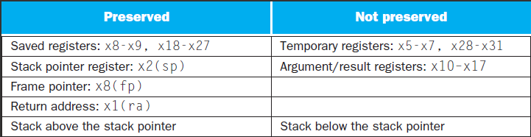
What is and what is not preserved across a procedure call

Slide 66
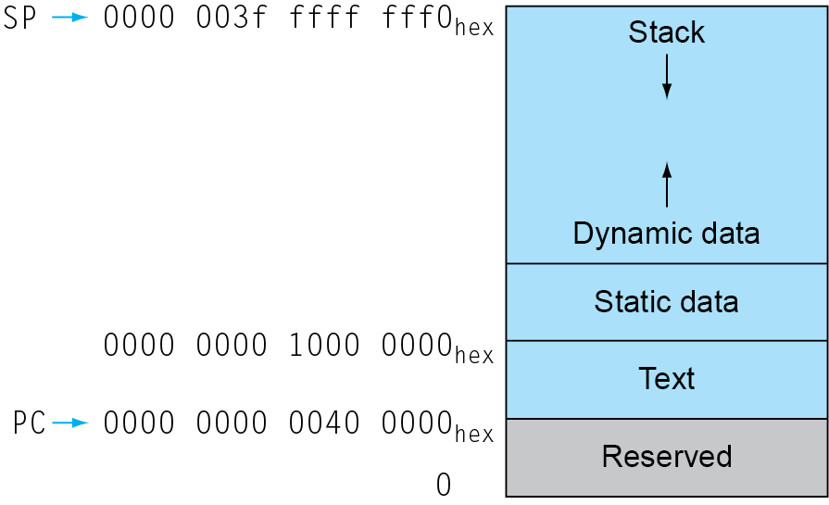
Memory Layout
Text: program code
Static data: global variables
  e.g., static variables in C, constant arrays and strings
  x3 (global pointer) initialized to address allowing ±offsets into this segment
Dynamic data: heap
  E.g., malloc in C, new in Java
Stack: automatic storage
Chapter 2 — Instructions: Language of the Computer — <number>
Notes:
The University of Adelaide, School of Computer Science
Chapter 2 — Instructions: Language of the Computer

Slide 67
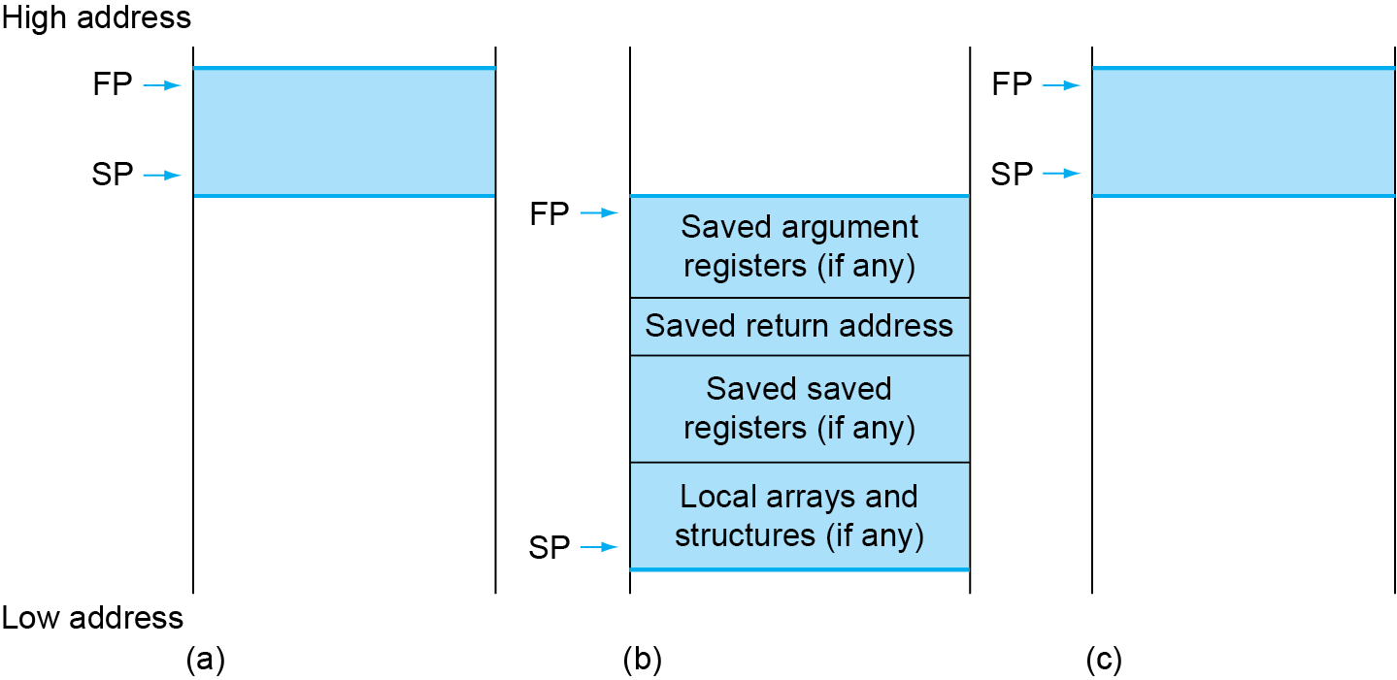
Local Data on the Stack
Local data allocated by callee
  e.g., C automatic variables
Procedure frame (activation record)
  Used by some compilers to manage stack storage
Chapter 2 — Instructions: Language of the Computer — <number>
Notes:
The University of Adelaide, School of Computer Science
Chapter 2 — Instructions: Language of the Computer

Slide 68
RISC-V register conventions
Name | Register name | Usage | Preserved On call?
x0 | 0 | The constant value 0 | n.a.
x1(ra) | 1 | Return address(link register) | yes
x2(sp) | 2 | Stack pointer | yes
x3(gp) | 3 | Global pointer | yes
x4(tp) | 4 | Thread pointer | yes
x5-x7 | 5-7 | Temporaries | no
x8-x9 | 8-9 | Saved | yes
x10-x17 | 10-17 | Arguments/results | no
x18-x27 | 18-27 | Saved | yes
x28-x31 | 28-31 | Temporaries | no

Slide 69
2.9 communication with people
Byte-encoded character sets
  ASCII: 128 characters
    95 graphic, 33 control
  Latin-1: 256 characters
    ASCII, +96 more graphic characters
Unicode: 32-bit character set
  Used in Java, C++ wide characters, …
  Most of the world’s alphabets, plus symbols
  UTF-8, UTF-16: variable-length encodings

Slide 70
Byte/Halfword/Word Operations
RISC-V byte/halfword/word load/store
  Load byte/halfword/word: Sign extend to 64 bits in rd
    lb rd, offset(rs1)
    lh rd, offset(rs1)
    lw rd, offset(rs1)
  Load byte/halfword/word unsigned: Zero extend to 64 bits in rd
    lbu rd, offset(rs1)
    lhu rd, offset(rs1)
    lwu rd, offset(rs1)
  Store byte/halfword/word: Store rightmost 8/16/32 bits
    sb rs2, offset(rs1)
    sh rs2, offset(rs1)
    sw rs2, offset(rs1)
Chapter 2 — Instructions: Language of the Computer — <number>
Notes:
The University of Adelaide, School of Computer Science
Chapter 2 — Instructions: Language of the Computer

Slide 71
Three choices for representing a string
  Place the length of the string in the first position
  An accompanying variable has the length
  A character in the last position to mark the end of a string
C uses the third choice
  Terminate a string with a byte whose value is 0 ( null in ASCII )
Notes:
1.1 Introduction
ASCII ((American Standard Code for Information Interchange): 美国信息交换标准代码）是基于拉丁字母的一套电脑编码系统，主要用于显示现代英语和其他西欧语言。它是最通用的信息交换标准，并等同于国际标准ISO/IEC 646。ASCII第一次以规范标准的类型发表是在1967年，最后一次更新则是在1986年，到目前为止共定义了128个字符
0x30 （48） 字符0， 0x41 （65） 字符A ， 0x61 （97） 字符a， 0x00 （0） null
为什么没有 sbu

Slide 72
Example Compiling a string copy procedure
( Assume: i ---- x19 x’s base –---x10, y’s base ----x11)
  C code:Y→X
  void strcpy ( char x[ ] , char y[ ] )
  {
  size_t i ;
  i = 0 ;
  while ( ( x[ i ] = y[ i ] ) != ‘\ 0’ ) /* copy and test byte */
  i += 1 ;
  }
  RISC-V assembly code:
  strcpy: addi sp, sp, 8 // adjust stack for 1 more item
  sd x19, 0(sp) // save x19
  add x19, x0, x0 // i = 0
  L1: add x5, x19, x11 // address of y[ i ] in x5
  lbu x6, 0(x5) // x6 = y [ i ]
  add x7, x19, x10 // address of x[ i ] in x7
  sb x6, 0(x7) // x[ i ] = y[ i ]
Notes:
课本第110页
注意到 y和x 都是一个byte 数组，所以不需要乘8
1.1 Introduction

Slide 73
beq x6, x0, L2 // if y[ i ] == 0, go to L2
addi x19, x19, 1 // i = i + 1
jal x0, L1 // go to L1
L2: ld x19, 0(sp) // restore x19
addi sp, sp, 8 // pop 1 word off stack
jalr x0, 0(x1) // return
Optimization for example
  strcpy is a leaf procedure
  Allocate i to a temporary register x28
For a leaf procedure
  The compiler exhausts all temporary registers
  Then use the registers it must save
Notes:
叶子程序，使用临时变量，没有其他程序会用到本程序所调用的变量
尽可能使用临时变量， 尽量不去使用stack 去缓存
1.1 Introduction

Slide 74
2.10 RISC-V Addressing for Wide Immediate and Addresses
Wide Immediate addressing
  most constants is short and fit into 12-bit field, sometimes they are bigger.
  Set upper 20 bits of a constants in a register with load upper immediate (lui), it uses a new instruction format (U-type)
| imm[31:12] | rd | opcode |
  20bits 5 bits 7 bits
  Loading a 32-bit Constant ( x19 = 0x12345678)
    lui x19 , 0x12345
    addi x19, x19, 0x678
    Note:Why does it need two steps?
Notes:
1.1 Introduction
回忆一下我们的mips 例子 【20位地址空间】

Slide 75
Addressing in branches
  SB-type: bne x10, x11, 2000
  UJ-type:jal x0, 2000
  PC-relative addressing
    PC = PC + Branch offset
0 | 111110 | 01011 | 01010 | 001 | 1000 | 0 | 1100111
imm[12] | imm[10:5] | rs2 | rs1 | funct3 | imm[4:1] | imm[11] | opcode
0 | 1111101000 | 0 | 00000000 | 00000 | 1101111
imm[20] | imm[10:1] | imm[11] | imm[19:12] | rd | opcode
Notes:
SB-type:
Bne, 后面的必须是偶数。 The address uses unusual encoding
Jal 是唯一的一条UJ-type指令 （the unconditional jump-and-link instruction）
2000 = （11111010000）bin = （0111，1101，0000）bin
注意到这两个地址空间是不是一样的。 Bne 是12， jal 是20
1.1 Introduction

Slide 76
Example (p116) Show branch offset in machine language
  C language (p94):
  while (save[i]==k) i=i+1;
  RISC-V assembler code :
  Loop: slli x10, x22, 3 // temp reg x10 = 8 * i
  add x10, x10, x25 // x10 = address of save[i]
  ld x9, 0(x10) // temp reg x9 = save[i]
  bne x9, x24, Exit // go to Exit if save[i] != k
  addi x22, x22, 1 // i = i + 1
  beq x0, x0, Loop // go to Loop
  Exit:

Slide 77
  Assembled instructions and their addresses:
80000 | 0 | 3 | 22 | 1 | 10 | 19 |
80004 | 0 | 25 | 10 | 0 | 10 | 51 |
80008 | 0 | 0 | 10 | 3 | 9 | 3 |
80012 | 0 | 24 | 9 | 1 | 12 | 103 |
80016 | 0 | 1 | 22 | 0 | 22 | 19 |
80020 | 127 | 0 | 0 | 0 | 13 | 99 |
80024 . . .
  Modification:
    All RISC-V instructions are 4 bytes long
    PC-relative addressing refers to the number of halfwords
slli
add
ld
bne
addi
beq
PC+offset=80012+12=80024
Notes:
前面的例子转成二进制
注意到用的是相对的offset （除非跳转到非常远的地方）
1.1 Introduction

Slide 78
While branch target is far away
  Inserts an unconditional jump to target
  Invert the condition so that the branch decides whether to skip the jump
Example (p117) Branching far away
  Given a branch:
  beq x10, x0, L1
  Rewrite it to offer a much greater branching distance:
    bne x10, x0, L2
    jal x0, L1
    L2:
Notes:
跳到一个12bit 地址长之外的 地址
X10 等于0， 然后跳转到 L1 Beq的地址空间是 12bit
如果X10 不等于0， 跳转到L2
如果X10 等于0， 就执行下一句。 下一句是 Jal 【Jal 的地址空间是 20 bit】
1.1 Introduction

Slide 79
RISC-V addressing mode summary
  Register addressing:
    add x5,x6,x7
  Base addressing:
    ld x5,100(x6)
  Immediate addressing:
    addi x5,x6,4
  PC-relative addressing:
    beq x5,x6,L1
Notes:
PC-relative addressing: 其中的L1是相对寻址
1.1 Introduction

Slide 80
Example (p120) Decoding machine code
  Machine instruction (0x00578833)
  0000 0000 0101 0111 1000 1000 0011 0011
  Decoding
    Determine the operation from opcode
    opcode: 0110011 → R-type arithmetic instruction
| funct7 | rs2 | rs1 | funct3 | rd | opcode |
  0000000 00101 01111 000 10000 0110011
  funct7 and funct3 are all 0 → add instruction
    Determine other fields
    rs2: x5; rs1: x15; rd: x16
    Show the assembly instruction
    add x16, x15, x5 (Note: add rd,rs1,rs2)

Slide 81
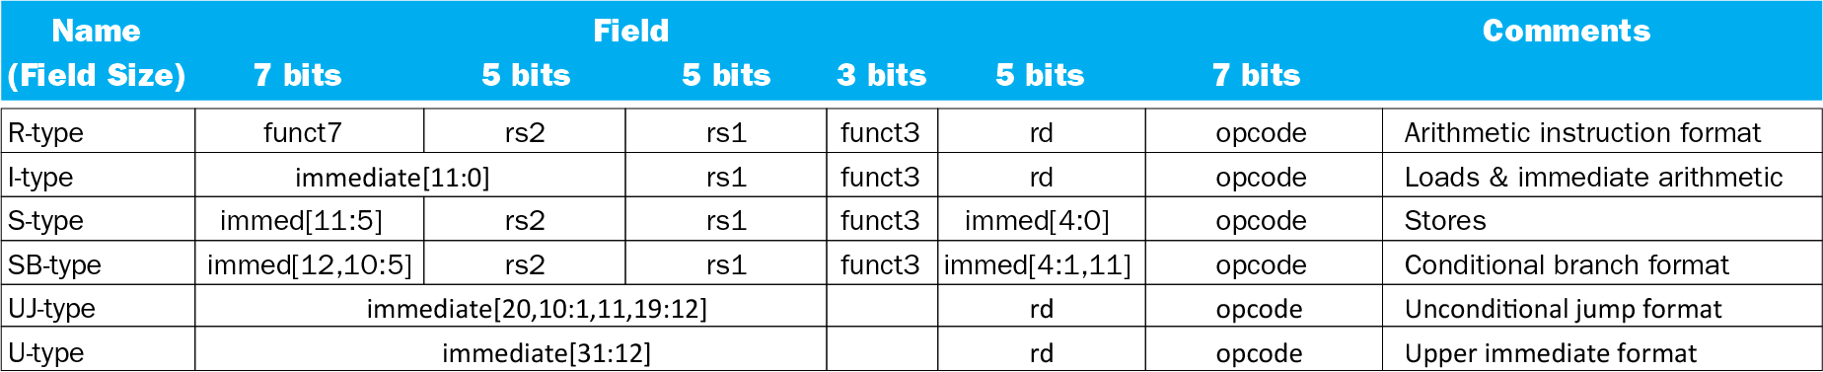
RISC-V encoding summary

Slide 82
Summary of RISC-V instruction encoding
Format | Instruction | Opcode | Funct3 | Funct6/7
R-type | add | 0110011 | 000 | 0000000
 | sub | 0110011 | 000 | 0100000
 | sll | 0110011 | 001 | 0000000
 | xor | 0110011 | 100 | 0000000
 | srl | 0110011 | 101 | 0000000
 | sra | 0110011 | 101 | 0000000
 | or | 0110011 | 110 | 0000000
 | and | 0110011 | 111 | 0000000
 | lr.d | 0110011 | 011 | 0001000
 | sc.d | 0110011 | 011 | 0001100

Slide 83
Format | Instruction | Opcode | Funct3 | Funct6/7
I-type | lb | 0000011 | 000 | n.a.
 | lh | 0000011 | 001 | n.a.
 | lw | 0000011 | 010 | n.a.
 | ld | 0000011 | 011 | n.a.
 | lbu | 0000011 | 100 | n.a.
 | lhu | 0000011 | 101 | n.a.
 | lwu | 0000011 | 110 | n.a.
 | addi | 0010011 | 000 | n.a.
 | slli | 0010011 | 001 | 000000
 | xori | 0010011 | 100 | n.a.
 | srli | 0010011 | 101 | 000000
 | srai | 0010011 | 101 | 010000
 | ori | 0010011 | 110 | n.a.
 | andi | 0010011 | 111 | n.a.
 | jalr | 1100111 | 000 | n.a.

Slide 84
Format | Instruction | Opcode | Funct3 | Funct6/7
S-type | sb | 0100011 | 000 | n.a.
 | sh | 0100011 | 001 | n.a.
 | sw | 0100011 | 010 | n.a.
 | sd | 0100011 | 111 | n.a.
SB-type | beq | 1100111 | 000 | n.a.
 | bne | 1100111 | 001 | n.a.
 | blt | 1100111 | 100 | n.a.
 | bge | 1100111 | 101 | n.a.
 | bltu | 1100111 | 110 | n.a.
 | bgeu | 1100111 | 111 | n.a.
U-type | lui | 0110111 | n.a. | n.a.
UJ-type | jal | 1101111 | n.a. | n.a.
Notes:
load upper immediate LUI
1.1 Introduction

Slide 85
2.11 Parallelism and Instructions: Synchronization
cause
  multiprocessors
  task preemption
  interrupt
result
  data race
  resources race
  Critical region
solution
  synchronization
    mutual exclusion、semaphore …
  hardware level
    atomic exchange or atomic swap (instructions in RISC-V: lr.d and sc.d)
Notes:
1.1 Introduction

Slide 86
a pair of instructions
  lr.d: load-reserved doubleword
  sc.d: store-conditional doubleword. If the contents of the memory location specified by lr.d are changed before the sc.d to the same address occurs, then the store-conditional fails and does not write the value to memory.
Example implements an atomic exchange
again: lr.d x10, (x20) // load reserved
sc.d x11, x23 , (x20) // store conditional
bne x11, x0, again // branch if store fails
addi x23, x10, 0 // put loaded value in x23
Notes:
1.1 Introduction

Slide 87
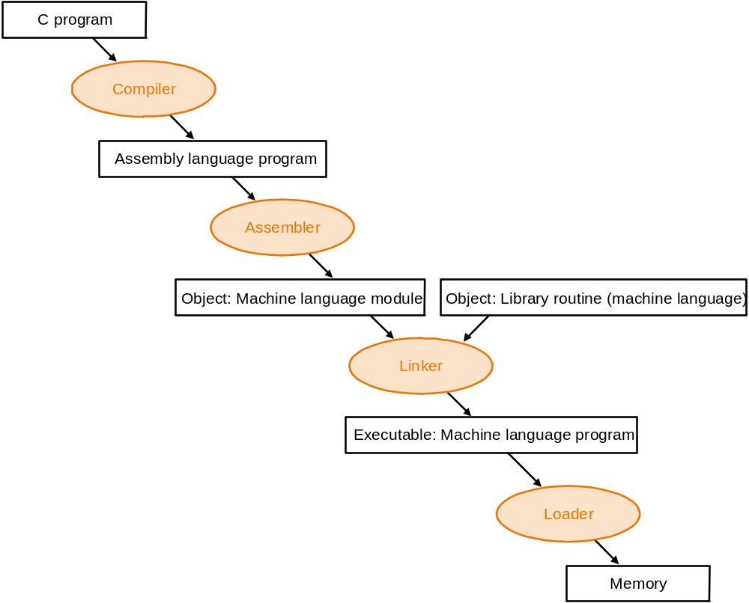
2.12 Translating and Starting a Program
Notes:
1.1 Introduction

Slide 88
Start a C program in a file on disk to run
object file
Compiling
  C program → assembly language program
Assembling
  Assembly language program → machine language module
  pseudoinstructions
    mv x10,x11 // register x10 gets register x11
    add x10, x11, x0
  Symbol table
    A table that matches name of lables to the addresses of the memory words that instructions occupy.
  Producing an object file of UNIX (six distinct pieces)

Slide 89
Object file
    object file header—size and position of the other pieces
    Text segment
    static data segment and dynamic data
  The relocation information ----identifies absolute addresses of instruction and data words when the program is loaded into memory
  symbol table
  Debugging information
Object file header
 | Name | Procedure A
 | Text size | 100_{hex}
 | Data size | 20_{hex}
Text segment | Address | instruction
 | 0 | ld x10, 0(gp)
 | 4 | jal x1, 0
 | …… | --
Data segment | 0 | (X)
 | …… | ……
Relocation information | Address | Instruction type | Dependency
 | 0 | ld | X
 | 4 | jal | B
Symbol table | label | Address
 | X | --
 | B | --

Slide 90
Linking
  Object modules(including library routine) → executable program
  3 step of Link
    Place code and data modules symbolically in memory
    Determine the addresses of data and instruction labels
    Patch both the internal and external references (Address of invoke)
RISC-v memory allocation for program and data
sp
7fff fffc_{hex}
Stack
Dynamic data
gp
1000 8000_{hex}
Static data
1000 0000_{hex}
Text
PC
0040 0000_{hex}
Reserved
0

Slide 91
Loading
  Determine size of text and data segments
  Create an address space large enough
  Copy instructions and data from executable file to memory
  Copy parameters (if any) to the main program onto the stack
  Initialize registers and set $sp to the first free location
  Jump to a start-up routine

Slide 92
Dynamic Linking
Only link/load library procedure when it is called
  Requires procedure code to be relocatable
  Avoids image bloat caused by static linking of all (transitively) referenced libraries
  Automatically picks up new library versions
Chapter 2 — Instructions: Language of the Computer — <number>
Notes:
The University of Adelaide, School of Computer Science
Chapter 2 — Instructions: Language of the Computer

Slide 93
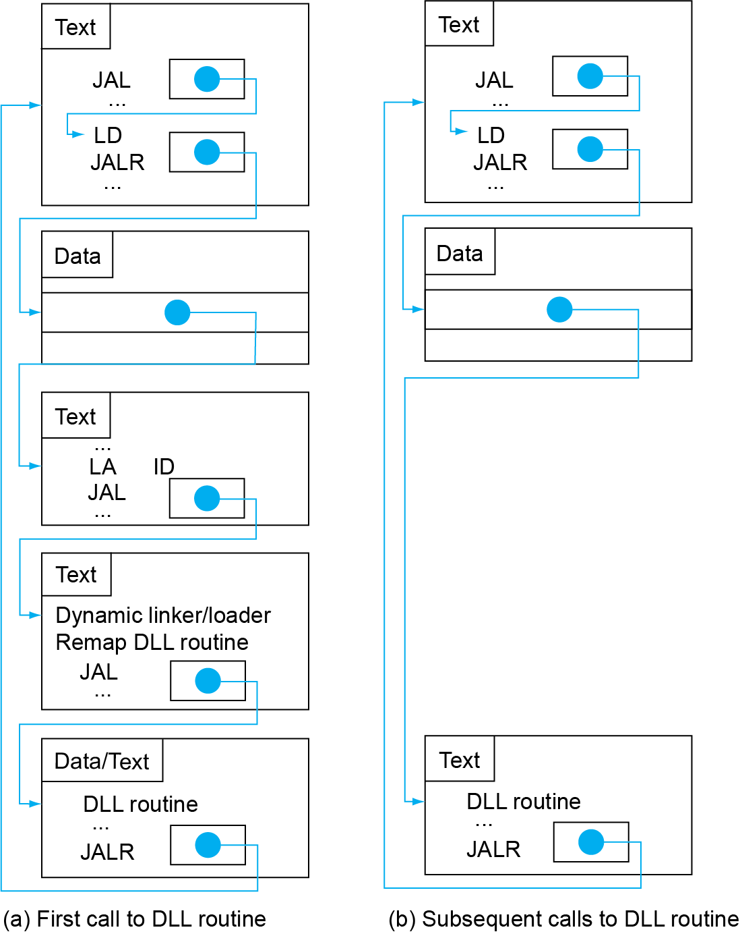
Lazy Linkage
Indirection table
Stub: Loads routine ID,
Jump to linker/loader
Linker/loader code
Dynamically
mapped code
Chapter 2 — Instructions: Language of the Computer — <number>
Notes:
The University of Adelaide, School of Computer Science
Chapter 2 — Instructions: Language of the Computer

Slide 94
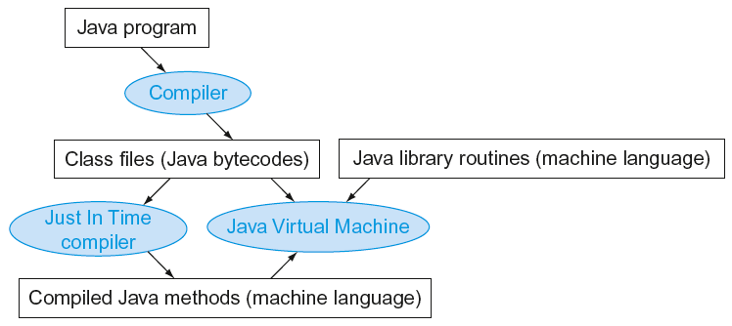
Starting Java Applications
Simple portable instruction set for the JVM
Compiles bytecodes of “hot” methods into native code for host machine
Interprets bytecodes
Chapter 2 — Instructions: Language of the Computer — <number>
Notes:
The University of Adelaide, School of Computer Science
Chapter 2 — Instructions: Language of the Computer

Slide 95
2.13 A C Sort Example To Put it All Together
Three general steps for translating C procedures
  Allocate registers to program variables
  Produce code for the body of the procedures
  Preserve registers across the procedures invocation
Procedure swap
  C code
  void swap ( long long v[ ] , size_t k )
  {
  long lon temp ;
  temp = v[ k ] ;
  v[ k ] = v[ k + 1 ] ;
  v[ k + 1 ] = temp ;
  }
Notes:
1.1 Introduction

Slide 96
  Register allocation for swap
  v ---- x10 k ---- x11 temp ---- x5
  swap is a leaf procedure, nothing to preserve
  RISC-V code for the procedure swap
    Procedure body
  swap: slli x6, x11, 3 // x6 = k * 8
  add x6, x10, x6 // x6 = v + ( k * 8 )
  ld x5, 0(x6) // x5 ← v[ k ]
  ld x7, 8(x6) // x7 ← v[ k + 1 ]
  sd x7, 0(x6) // v[k+1] → v[ k ]
  sd x5, 8(x6) // v[k] → v[ k + 1 ]
    Procedure return
  jalr x0, 0(x1) // return to calling routine

Slide 97
Procedure sort
  C code
  void sort (long long v[ ] , size_t n )
  {
  size_t i , j ;
  for ( i = 0 ; i < n ; i + = 1 ) {
  for ( j = i - 1 ; j >= 0 && v[j] > v[j+1] ; j -= 1 )
  swap ( v , j ) ;
  }
  }
  Register allocation for sort
  v ---- x10 n ---- x11 i ---- x19 j ---- x20
  Passing parameters in sort
  Preserving registers in sort
  x1 , x19, x20, x21, x22
If V[0]> V[1]
V[0]
V[1]
V[2]
……
V[n-1]

Slide 98
  Code for the procedure sort
    Saving registers
  sort: addi sp, sp, -40 // make room on stack for 5 registers
  sd x1, 32(sp) // save return address on stack
  sd x22, 24(sp) // save x22 on stack
  sd x21, 16(sp) // save x21 on stack
  sd x20, 8(sp) // save x20 on stack
  sd x19, 0(sp) // save x19 on stack
    Procedure body{Outer loop {Inner loop} }
    Restoring registers
    exit1: ld x19, 0(sp) // restore x19 from stack
    ld x20, 8(sp) // restore x20 from stack
    ld x21, 16(sp) // restore x21 from stack
    ld x22, 24(sp) // restore x22 from stack
    ld x1, 32(sp) // restore return address from stack
    addi sp, sp, 40 // restore stack pointer
    Procedure return
    jalr x0, 0(x0) // return to calling routine

Slide 99
    Code for Procedure body
      Outer loop—first for loop
    for ( i = 0 ; i < n ; i + = 1 ) {
      Move parameters
      mv x21, x10 // copy parameter x10 into x21
      mv x22, x11 // copy parameter x11 into x22
      Outer loop
      li x19, 0 // i = 0
  for1tst: bge x19, x22, exit1 // go to exit1 if i >= n
      ………………
      （body of first for loop is second for loop）
      ………………
  exit2: addi x19, x19, 1 # i = i + 1
  j for1tst # jump to test of outer loop
  exit1:

Slide 100
      Inner loop-- second for loop is body of first for loop
    for ( j = i - 1 ; j >= 0 && v[j] > v[j+1] ; j- = 1 ){
      addi x20, x19, -1 // j = i - 1
for2tst: blt x20, x0, exit2 // go to exit2 if j < 0
    slli x5, x20, 3 // x5 = j * 8
    add x5, x21, x5 // x5 = the address of v[j]
    ld x6, 0(x5) // x6 = v[j]
    ld x7, 8(x5) // x7 = v[j + 1]
    blt x6, x7, exit2 // go to exit2 if v[j] < v[j+1]
      ………………
      （body of first for loop ）
    ………………
    addi x20, x20, -1 // j = j - 1
    j for2tst // jump to test of inner loop
  exit2:

Slide 101
      body of first for loop
      Pass parameters and call
    mv x10，x21 // first swap parameter v
    mv x11，x20 // second swap parameter j
      Call function swap
    jal x1, swap
Notice:
1.Why are x10 and x11 saved?
x10 is the base of the array v. x10 will be used repeatedly and might be(actually not here) changed by the procedure swap.
x11 is the size of the array v. x11 will be used repeatedly and changed before the procedure swap is called.
2.Why are they not pushed to stack?
  Register variable is faster

Slide 102
2.14 Arrays versus Pointers
Two C procedures
  Array version
  void clear1 ( long long array[ ], size_t size )
  {
  siaze_t i;
  for ( i = 0 ; i < size ; i = i + 1 )
  array[i] = 0;
  }
  Pointer version
  void clear2 ( long long *array, size_t size )
    {
    long long *p;
    for ( p = &array[0] ; p < &array[size] ; p = p + 1 )
    *p = 0;
    }
Notes:
1.1 Introduction

Slide 103
Assembly code for clear-1 procedure (array version)
  mv x5, x0 // i = 0
  loop1: slli x6, x5, 3 // x6 = i * 3
  add x7, x10, x6 // x7 = address of array[ i ]
  sd x0, 0(x7) // array[ i ] = 0
  addi x5, x5, 1 // i = i +1
  blt x5, x11, loop1 // if ( i < size ) go to loop1
  jalr x0, 0(x1)
  This code works as long as size is greater than 0.
  (In this case,the loop will be executed once even though the value of the size parameter is invalid. Actually,size >0 must be checked at first)

Slide 104
Assembly code for clear-2 procedure (pointer version)
  mv x5, x10 // p = the start address of the array[]
  slli x6, x11, 3
  add x7, x10, x6 // x7 = &array[size](address of array[size] )
  loop2: sd x0, 0(x5) // Memory[ p ] = 0
  addi x5, x5, 8 // p = p + 8
  bltu x5, x7, loop2 // if ( p < &array[size] ) go to loop2
  jalr x0, 0(x1)
  This code works as long as size is greater than 0.
Compare the two versions
  Array version has the “multiply” and add inside loop
  Pointer version reduces instructions/iteration from 5 to 3
For modern compliers,both ways are the same.

Slide 105
2.16 Real Stuff: MIPS Instructions
MIPS: commercial predecessor to RISC-V
Similar basic set of instructions
  32-bit instructions
  32 general purpose registers, register 0 is always 0
  32 floating-point registers
  Memory accessed only by load/store instructions
    Consistent use of addressing modes for all data sizes
Different conditional branches
  For <, <=, >, >=
  RISC-V: blt, bge, bltu, bgeu
  MIPS: slt, sltu (set less than, result is 0 or 1)
    Then use beq, bne to complete the branch
Chapter 2 — Instructions: Language of the Computer — <number>
Notes:
The University of Adelaide, School of Computer Science
Chapter 2 — Instructions: Language of the Computer

Slide 106
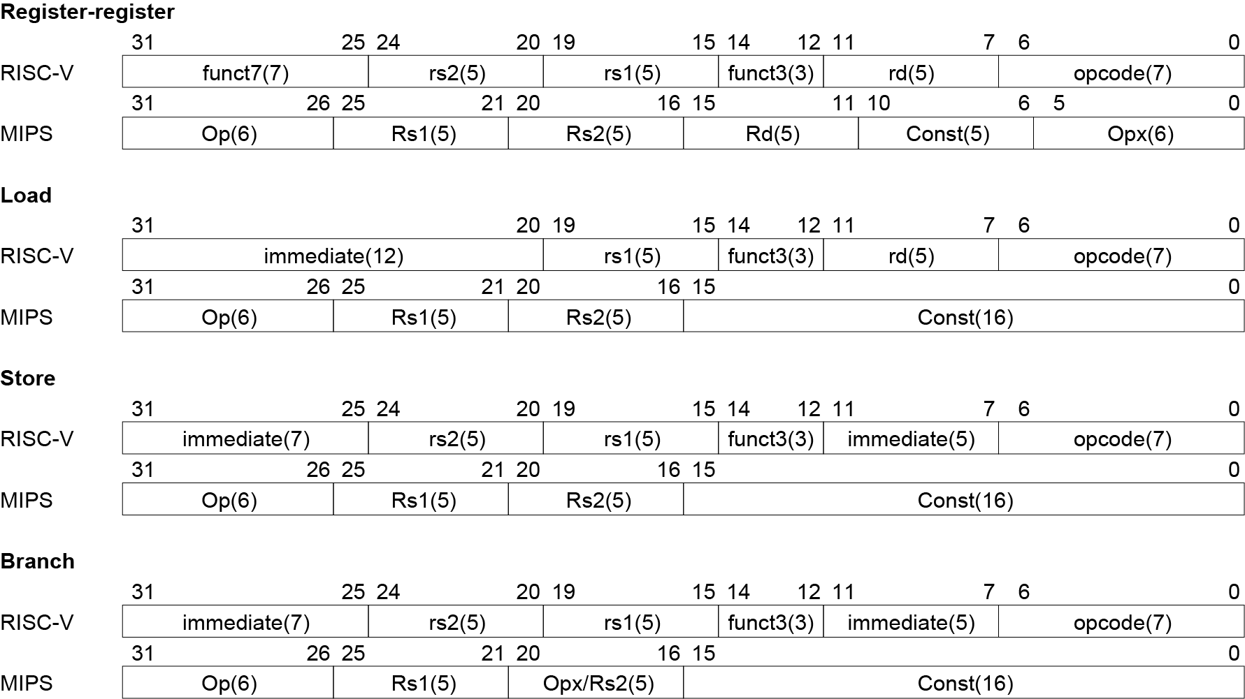
Instruction Encoding
Chapter 2 — Instructions: Language of the Computer — <number>
Notes:
The University of Adelaide, School of Computer Science
Chapter 2 — Instructions: Language of the Computer

Slide 107
2.17 Real Stuff: The Intel x86 ISA
Evolution with backward compatibility
  8080 (1974): 8-bit microprocessor
    Accumulator, plus 3 index-register pairs
  8086 (1978): 16-bit extension to 8080
    Complex instruction set (CISC)
  8087 (1980): floating-point coprocessor
    Adds FP instructions and register stack
  80286 (1982): 24-bit addresses, MMU
    Segmented memory mapping and protection
  80386 (1985): 32-bit extension (now IA-32)
    Additional addressing modes and operations
    Paged memory mapping as well as segments
Chapter 2 — Instructions: Language of the Computer — <number>
Notes:
The University of Adelaide, School of Computer Science
Chapter 2 — Instructions: Language of the Computer

Slide 108
The Intel x86 ISA
Further evolution…
  i486 (1989): pipelined, on-chip caches and FPU
    Compatible competitors: AMD, Cyrix, …
  Pentium (1993): superscalar, 64-bit datapath
    Later versions added MMX (Multi-Media eXtension) instructions
    The infamous FDIV bug
  Pentium Pro (1995), Pentium II (1997)
    New microarchitecture (see Colwell, The Pentium Chronicles)
  Pentium III (1999)
    Added SSE (Streaming SIMD Extensions) and associated registers
  Pentium 4 (2001)
    New microarchitecture
    Added SSE2 instructions
Chapter 2 — Instructions: Language of the Computer — <number>
Notes:
The University of Adelaide, School of Computer Science
Chapter 2 — Instructions: Language of the Computer

Slide 109
The Intel x86 ISA
And further…
  AMD64 (2003): extended architecture to 64 bits
  EM64T – Extended Memory 64 Technology (2004)
    AMD64 adopted by Intel (with refinements)
    Added SSE3 instructions
  Intel Core (2006)
    Added SSE4 instructions, virtual machine support
  AMD64 (announced 2007): SSE5 instructions
    Intel declined to follow, instead…
  Advanced Vector Extension (announced 2008)
    Longer SSE registers, more instructions
If Intel didn’t extend with compatibility, its competitors would!
  Technical elegance ≠ market success
Chapter 2 — Instructions: Language of the Computer — <number>
Notes:
The University of Adelaide, School of Computer Science
Chapter 2 — Instructions: Language of the Computer

Slide 110

Basic x86 Registers
Chapter 2 — Instructions: Language of the Computer — <number>
Notes:
The University of Adelaide, School of Computer Science
Chapter 2 — Instructions: Language of the Computer

Slide 111
Basic x86 Addressing Modes
Two operands per instruction
Source/dest operand | Second source operand
Register | Register
Register | Immediate
Register | Memory
Memory | Register
Memory | Immediate
Memory addressing modes
  Address in register
  Address = R_{base} + displacement
  Address = R_{base} + 2^{scale} × R_{index} (scale = 0, 1, 2, or 3)
  Address = R_{base} + 2^{scale} × R_{index} + displacement
Chapter 2 — Instructions: Language of the Computer — <number>
Notes:
The University of Adelaide, School of Computer Science
Chapter 2 — Instructions: Language of the Computer

Slide 112
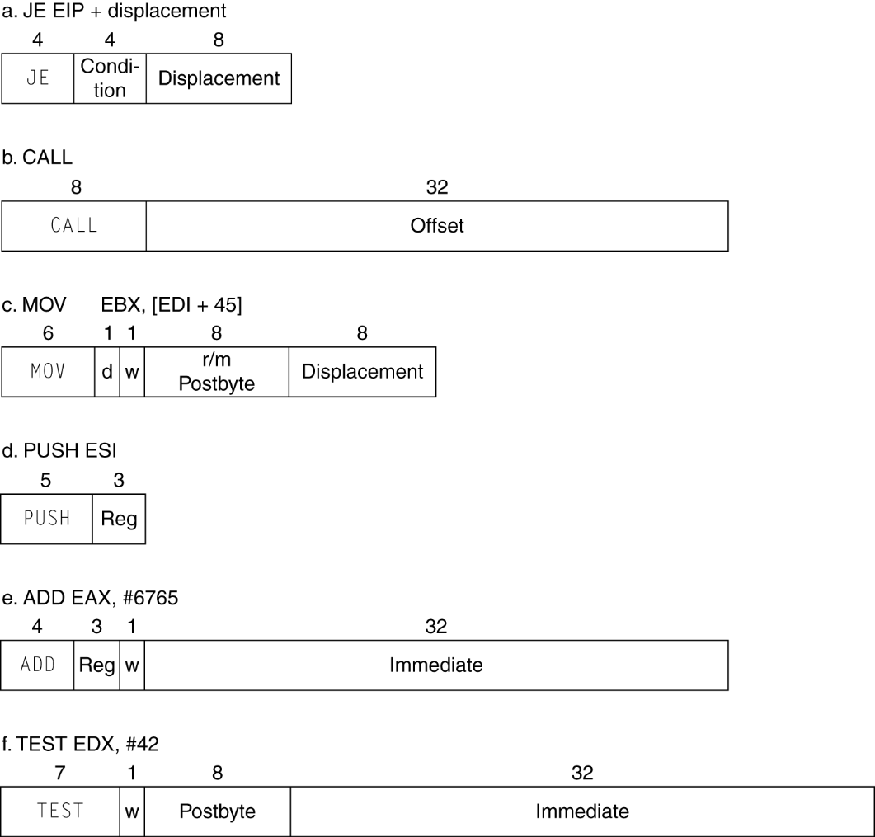
x86 Instruction Encoding
Variable length encoding
  Postfix bytes specify addressing mode
  Prefix bytes modify operation
    Operand length, repetition, locking, …
Chapter 2 — Instructions: Language of the Computer — <number>
Notes:
The University of Adelaide, School of Computer Science
Chapter 2 — Instructions: Language of the Computer

Slide 113
Implementing IA-32
Complex instruction set makes implementation difficult
  Hardware translates instructions to simpler microoperations
    Simple instructions: 1–1
    Complex instructions: 1–many
  Microengine similar to RISC
  Market share makes this economically viable
Comparable performance to RISC
  Compilers avoid complex instructions
Chapter 2 — Instructions: Language of the Computer — <number>
Notes:
The University of Adelaide, School of Computer Science
Chapter 2 — Instructions: Language of the Computer

Slide 114
2.18 Other RISC-V Instructions
Base integer instructions (RV64I)
  Those previously described, plus
  auipc rd, immed // rd = (imm<<12) + pc
    follow by jalr (adds 12-bit immed) for long jump
  slt, sltu, slti, sltui: set less than (like MIPS)
  addw, subw, addiw: 32-bit add/sub
  sllw, srlw, srlw, slliw, srliw, sraiw: 32-bit shift
32-bit variant: RV32I
  registers are 32-bits wide, 32-bit operations
Chapter 2 — Instructions: Language of the Computer — <number>

Slide 115
Instruction Set Extensions
M: integer multiply, divide, remainder
A: atomic memory operations
F: single-precision floating point
D: double-precision floating point
C: compressed instructions
  16-bit encoding for frequently used instructions
Chapter 2 — Instructions: Language of the Computer — <number>

Slide 116
Summary
Two principles of stored-program computers
  Use instructions as numbers
  Use alterable memory for programs
Four design principles
  Simplicity favors regularity
  Smaller is faster
  Good design demands good compromises
  Make the common case fast
RISC –V Instruction Set
Notes:
1.1 Introduction

Slide 117
END
Notes:
1.1 Introduction

